Slide 1
EEE 401 Enactment of Attributes Part 2 – E-folio
Jessica Rawlings
211267945

Slide 2
Attribute 1 - To further develop my knowledge and skills at differentiating teaching to meet the specific learning needs of students across the full range of abilities.
Meet with mentor and supervising teacher
Research school and external documents
Observe students and plan educative experiences
Attend Hawker Brownlow learning conference.

Slide 3
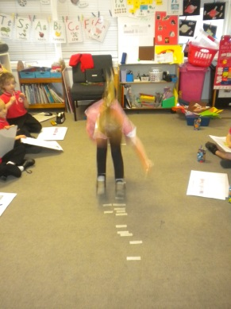
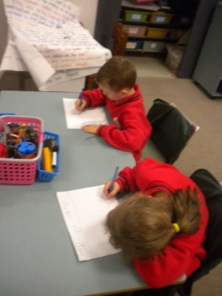
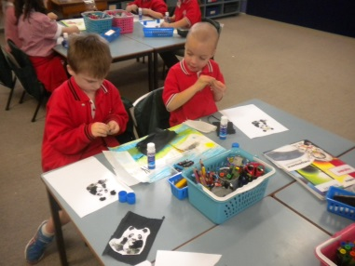
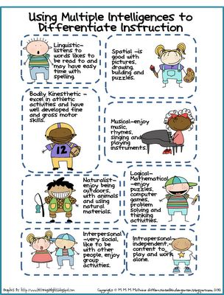
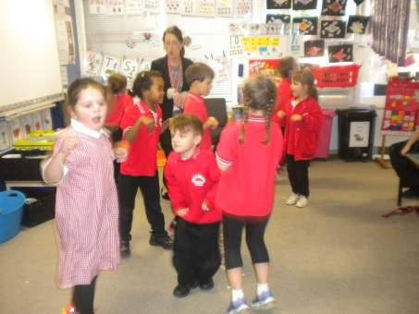
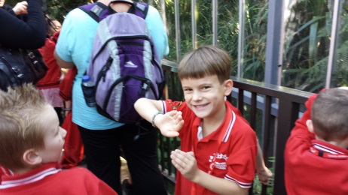
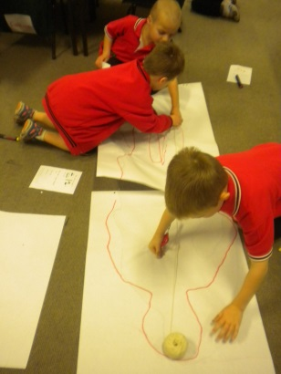
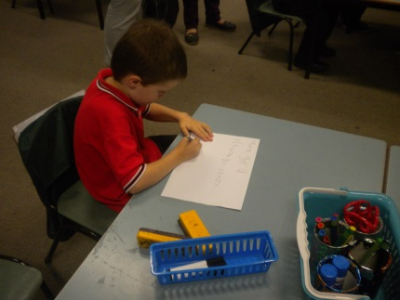
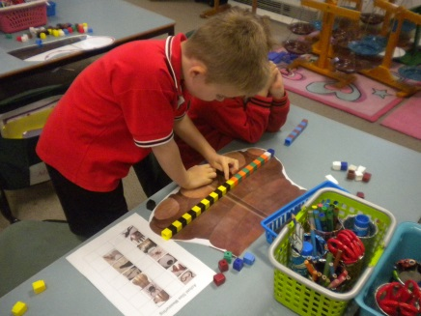
Literacy tasks
How far can you jump?
Maths activity
Craft and drawing
She is sensitive to individual
differences and is able to adapt
her communication to individual needs.
- Anita Bradshaw supervising teacher
Dancing to music
Jessica integrated our Science focus into
English and Math's lessons. She also played
highly engaging African music on a CD player in a lesson that linked our Science focus on animals to our school mission of developing Internationally minded learners.
- Anita Bradshaw supervising teacher
Zoo Excursion
Working in groups
Working autonomously
Hands on Maths activities

Slide 4
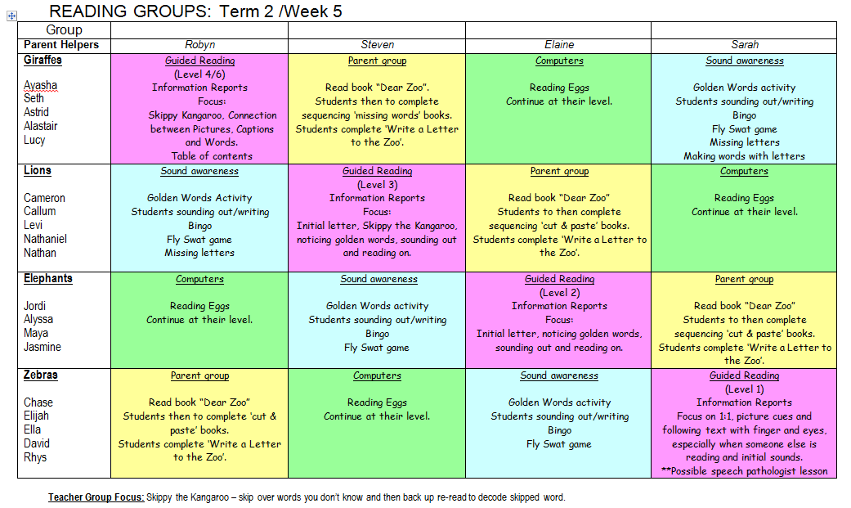
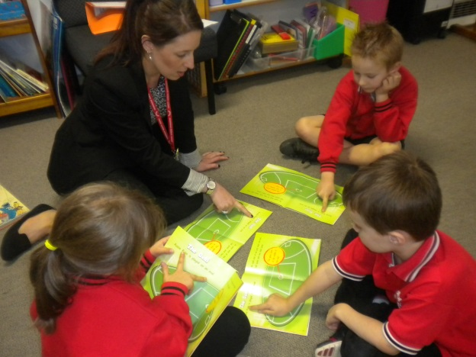
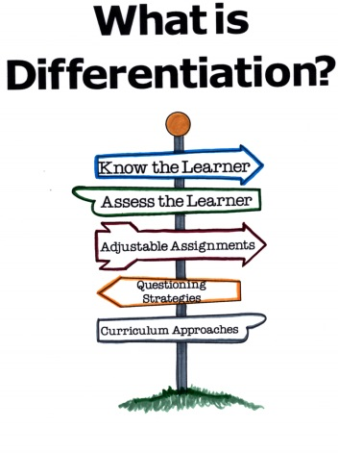
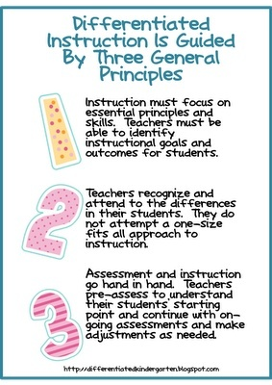
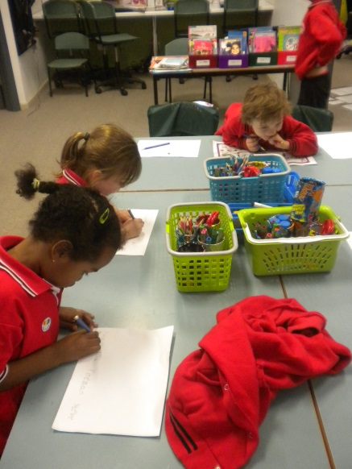
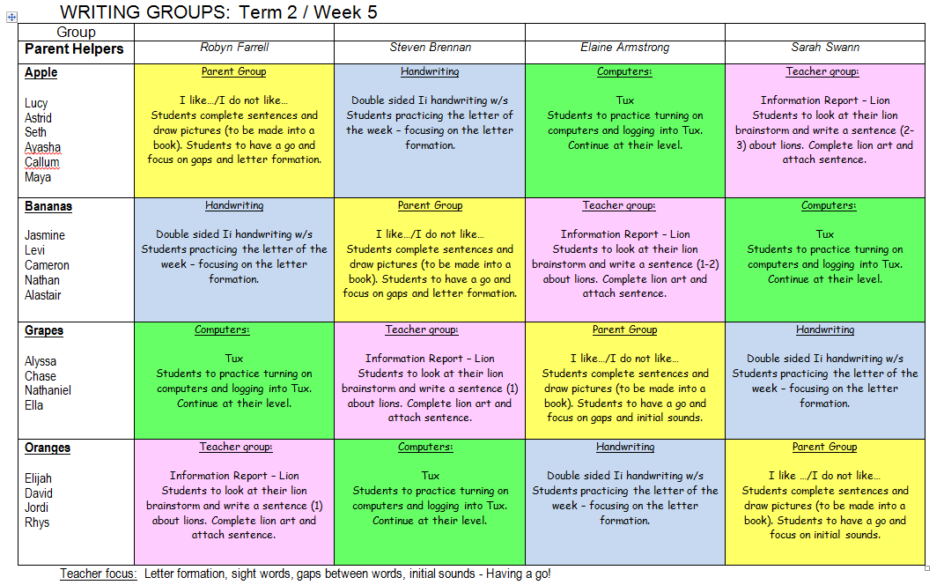
Jessica is aware of each
individual’s progress and
is able to group them in
order to differentiate
learning
– Anita Bradshaw
supervising teacher.
Differentiated Literacy Groups
Using writing samples and reading levels, I was able to group
the students into literacy groups for the week. I was then able to plan
for and set different goals for each group according to their learning needs.
At the end of the literacy groups, I reported back to my supervising teacher and gave
her my assessment of how the students went.
Jessica taught content that was relevant and appropriate to
the grade’s needs.
She ran differentiated literacy groups
– Anita Bradshaw supervising teacher.

Slide 5
Attribute 2 - Develop a range of strategies for developing an effective and positive learning environment.
Meet with mentor and supervising teacher
Plan and implement strategies
Research school and external documents and books that may be relevant
Attend Hawker Brownlow learning conference and PDs in the Pub.

Slide 6
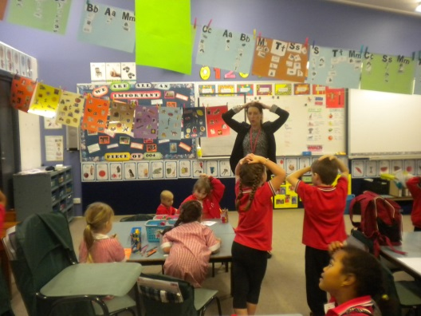
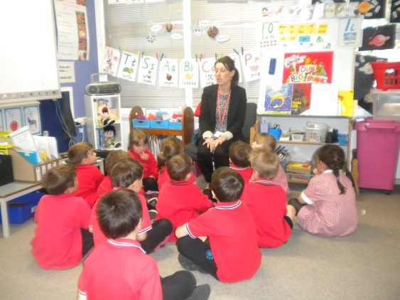
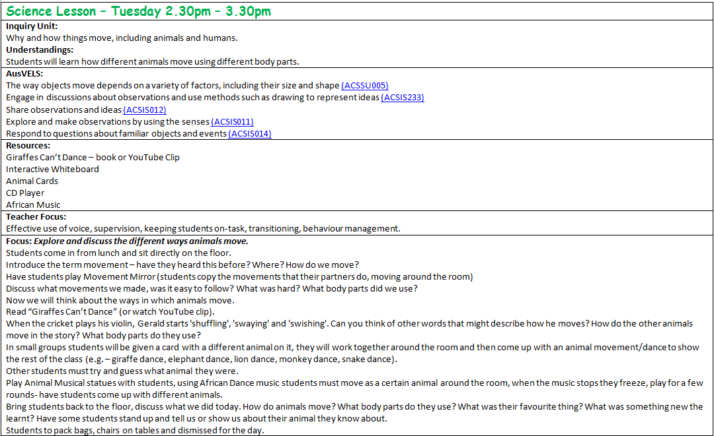
Jessica’s ability to relate to each child
as an individual is a real strength. She
strives to build a relationship with
everyone in the class.
- Anita Bradshaw supervising teacher
Jessica has a superb rapport with the
children in my grade. They regularly
ask about her and look forward to her
returning for another teaching round.
- Anita Bradshaw supervising teacher
Specific objectives:
Develop well-structured and detailed lessons
Work on my classroom management skills – effective use of voice, supervision, keeping students on-task, transitioning.
Account for a full range of learning needs and styles using a range of teaching and learning strategies
Create positive relationships with students,
“Hands on Top” using different strategies to gain students attention and transition between lessons.
Introducing lessons
It is good to see that Jessica is
developing her own style and uses
a calm, restrained voice. She is also developing the ability to maintain the flow of a lesson whilst dealing with disruptive behaviour.
- Anita Bradshaw supervising teacher
She was highly organised
and well prepared for
each lesson taught.
- Anita Bradshaw supervising teacher
Lesson plans

Slide 7
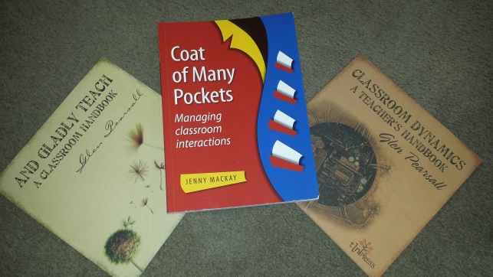
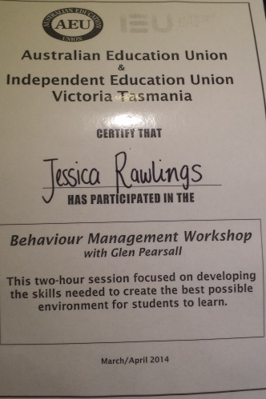
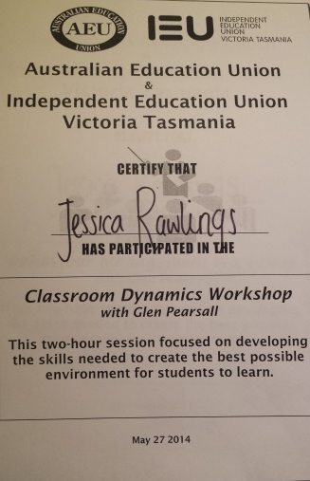
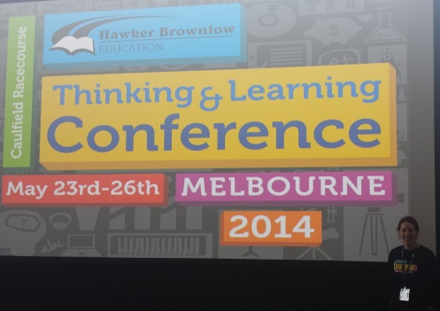
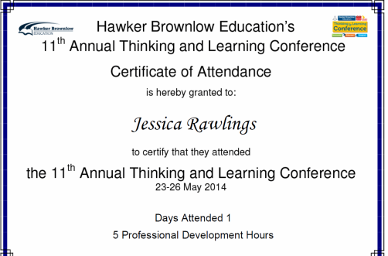
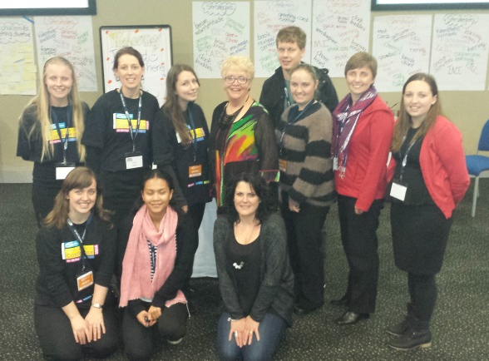
Resources
I attended PD’s and bought some relevant books, learning things that I will be able to use next placement, and undoubtedly throughout my teaching career.
PD’s in the Pub
During her next teaching round, Jessica will continue to focus on classroom management, and build up her repertoire of strategies to deal with disruptive behavior. She will also continue to work on lesson transitions and closures.
- Anita Bradshaw supervising teacher
Hawker Brownlow Conference

